Slide 1
S.O.L.I.D
(NOT a state)

Slide 2





Definition
An Acronym
Stand for

Slide 3
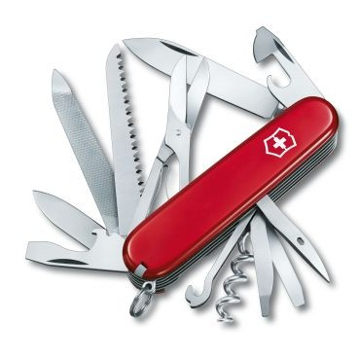
Single Responsibility
Just because you can, doesn't mean you should
Too many functions

Slide 4
“A class should have only one responsibility”
OR
“A class should has only one reason to change”

Slide 5

Responsibility
Is a work or action
Is “reason to change”
Explain why the class is exist
How to define a Responsibility?
It depend on “The X-Factor”

Slide 6
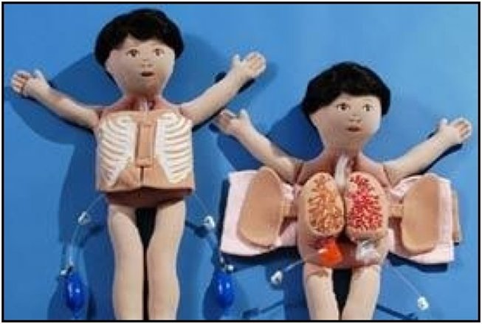
Open-closed
Open chest surgery is not needed
when putting on a coat.

Slide 7
“You should be able to extend a class behavior, without modifying it.”
OR
Software entities(classes, modules, functions, etc.) Should be OPEN for extensions, but CLOSED for modification.

Slide 8
Open and Closed
Open for “Extension”
This means that the behavior of the module can be extended. That we can make the module behave in new and different ways as the requirements of the application change, or to meet the needs of new applications.
Closed for “Modification”
The source code of such a module is inviolate. No one is allowed to make source code changes to it.

Slide 9
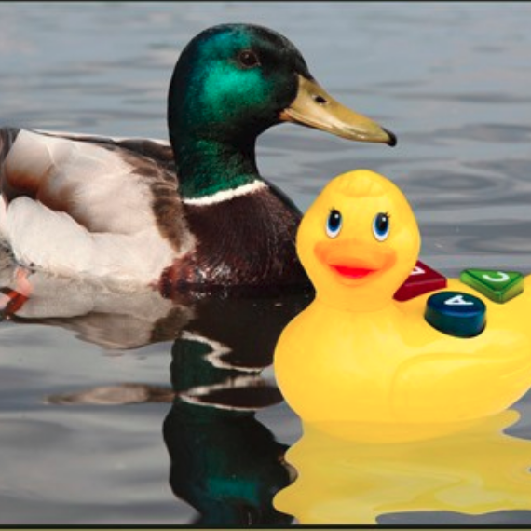
Liskov Substitution
It looks like a duck, quack like a duck but need batteries.
You probably have the wrong abstraction.

Slide 10
“Derived classes must be substitutable for their base classes.”
OR
Functions that use pointers or references to base classes must be able to use objects of derived classes without knowing it.

Slide 11
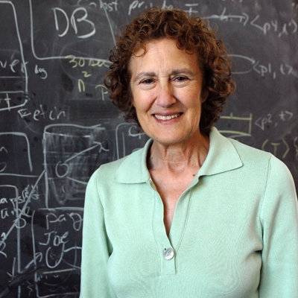
Barbara Liskov
“What is wanted here is something like the following substitution property: If
for each object o1 of type S there is an object o2 of type T such that for all
programs P defined in terms of T, the behavior of P is unchanged when o1 is
substituted for o2 then S is a subtype of T.”

Slide 12
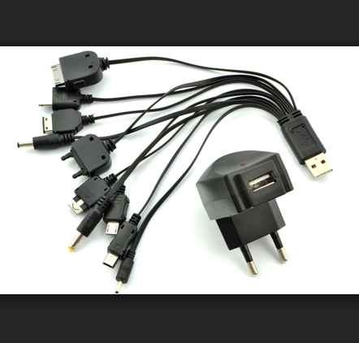
Interface Segregation
This cable contain some never used connector

Slide 13
“Make fine grained interfaces that are client specific.”
OR
Clients should not be forced to depend upon interfaces that they do not use.

Slide 14
Easier
“Many client-specific interfaces are better than one general purpose interface”
OR
“Try to make smallest interfaces “

Slide 15
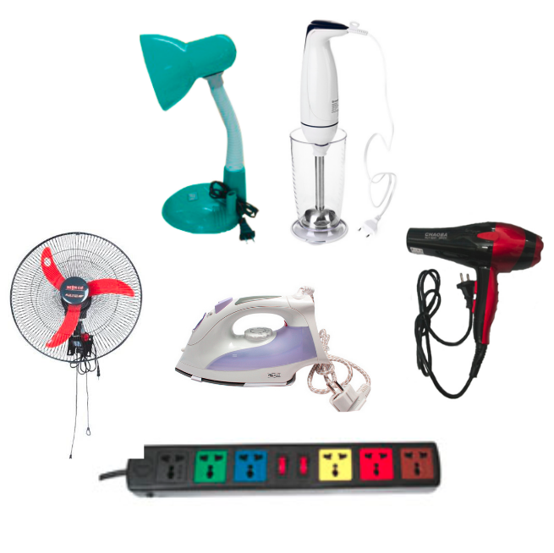
Dependency Inversion

Slide 16
“A. High level modules should not depend upon low level modules. both should depend upon abstractions.”
“B. abstractions should not depend upon details. details should depend upon abstractions.”

Slide 17
Easier
“Depend on abstractions, not on concretions.“

Slide 18

Why S.O.L.I.D?
Reusability
Maintainability
Flexibility
Less Fragile
Testability
Easy to Debugging
so on...

